Slide 1


Slide 2
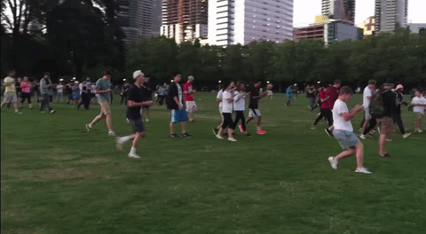

Slide 3

Why play in a virtual reality when you can play in the actual reality?
Much more fun!

Slide 4
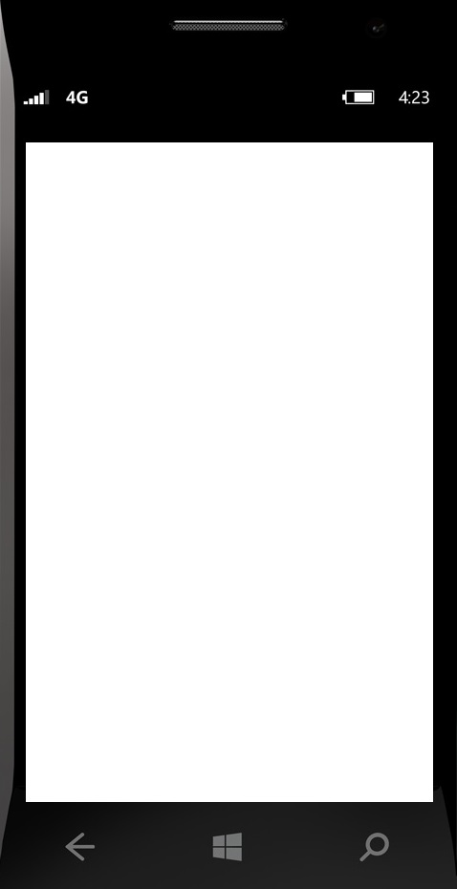
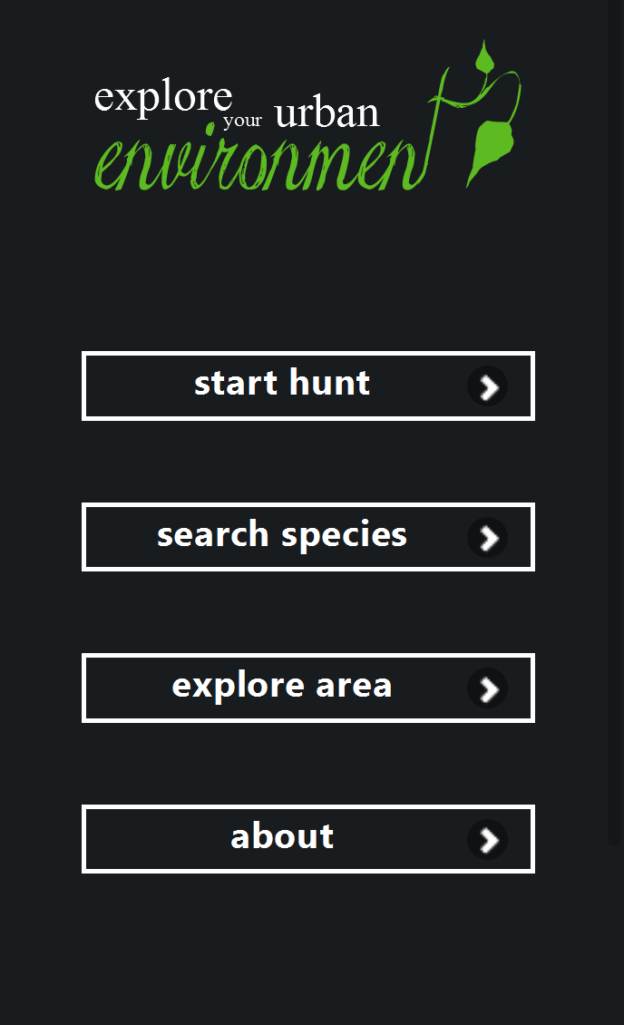

Slide 5
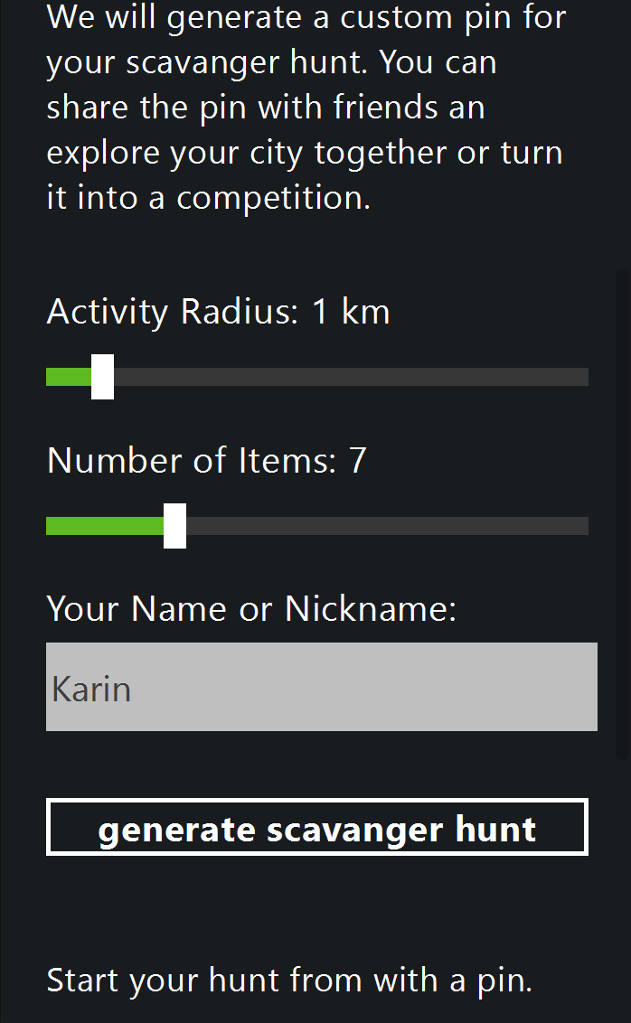

Do you want to explore your city by bike, public transport or on foot? Choose your action radius accordingly.
How many objects do you want to explore?
You don‘t have to register – just give a name or nickname for this game ;-)

Slide 6
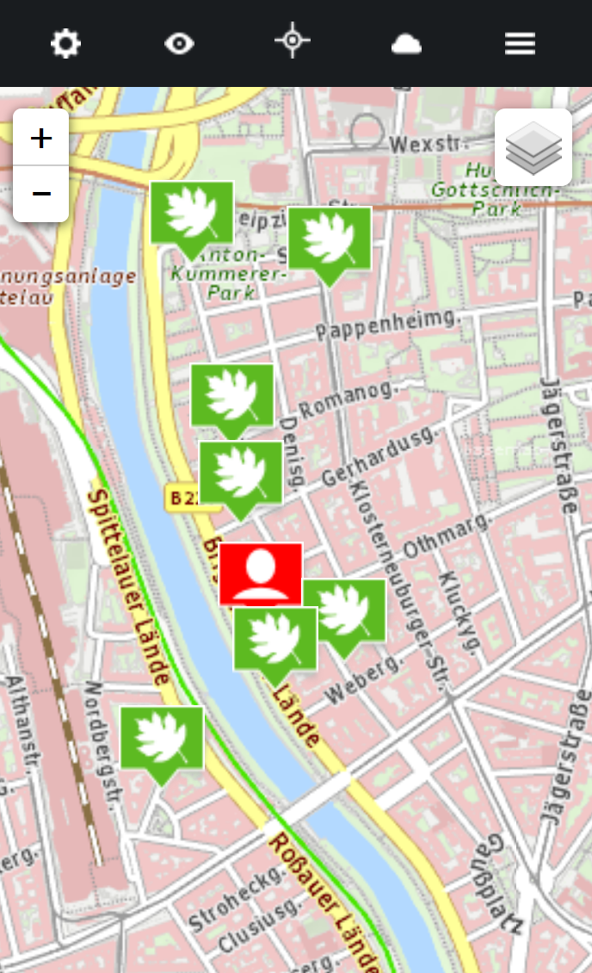
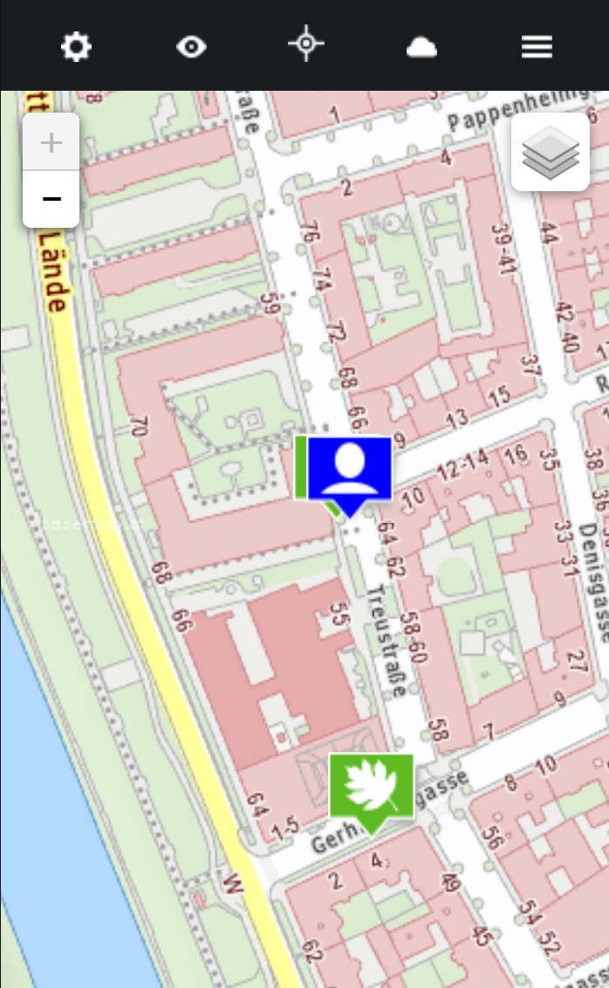
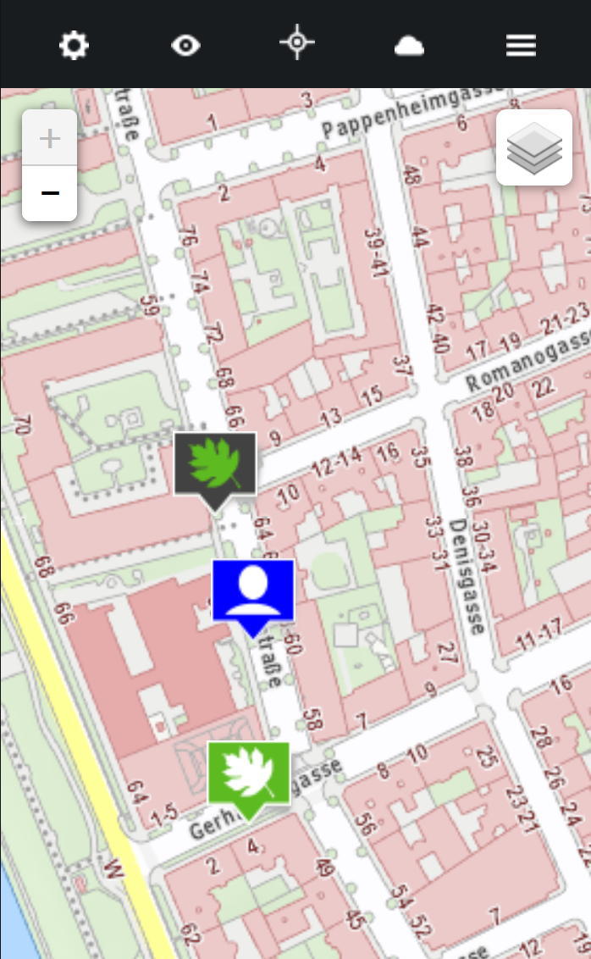
Step by Step guide:
Creep up on your leafy ‚target‘
Spot the ‚target‘ on your app
Optional: hug the ‚target‘
Proceed to the next ‚target‘ *StealthModeOn*
Repeat 1-4 while ‚targets‘ left

Slide 7
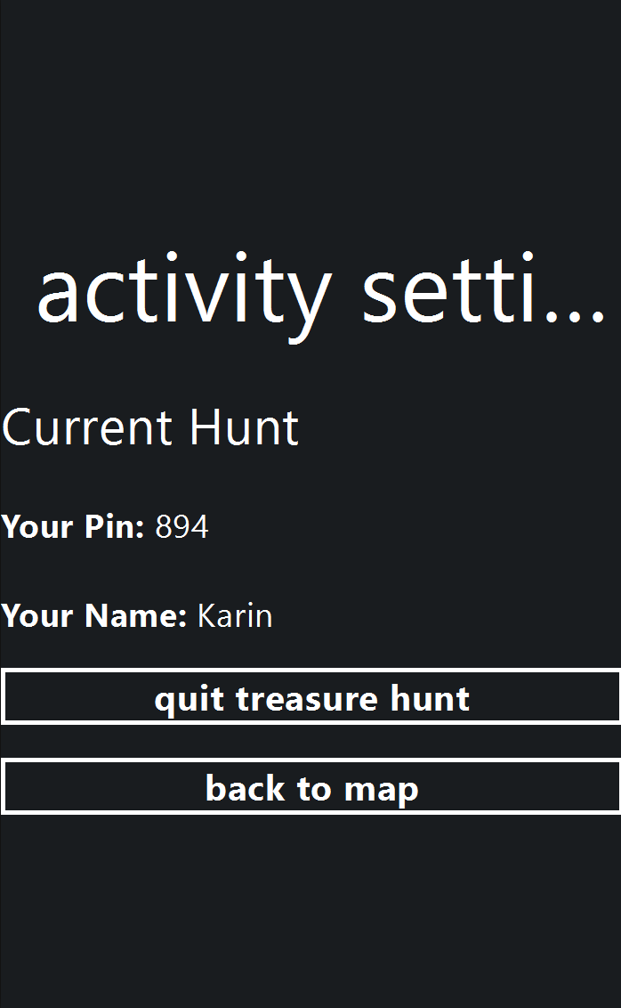
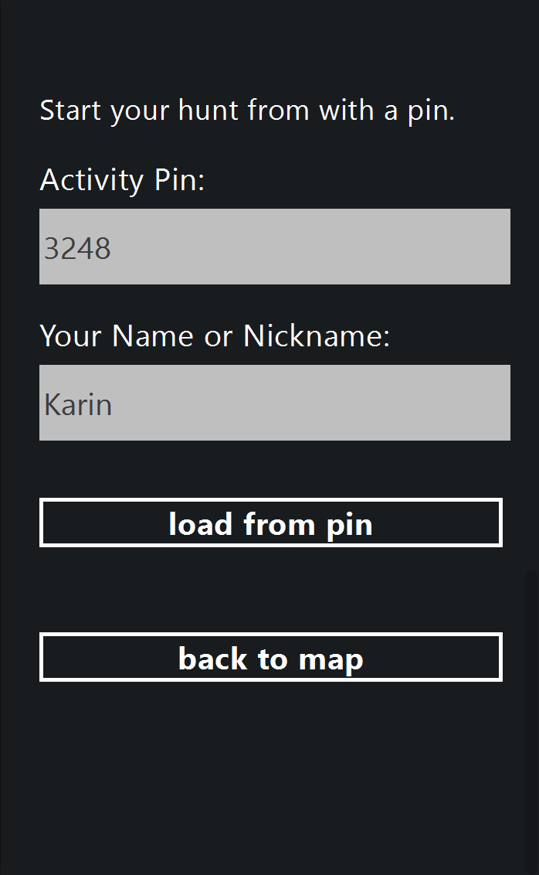
Share your Treasure Hunt ID und play with friends

Slide 8
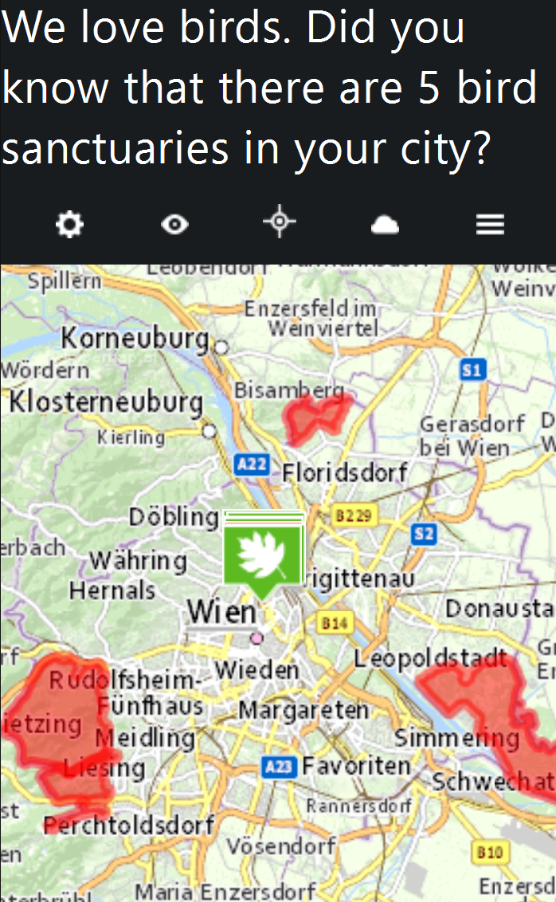
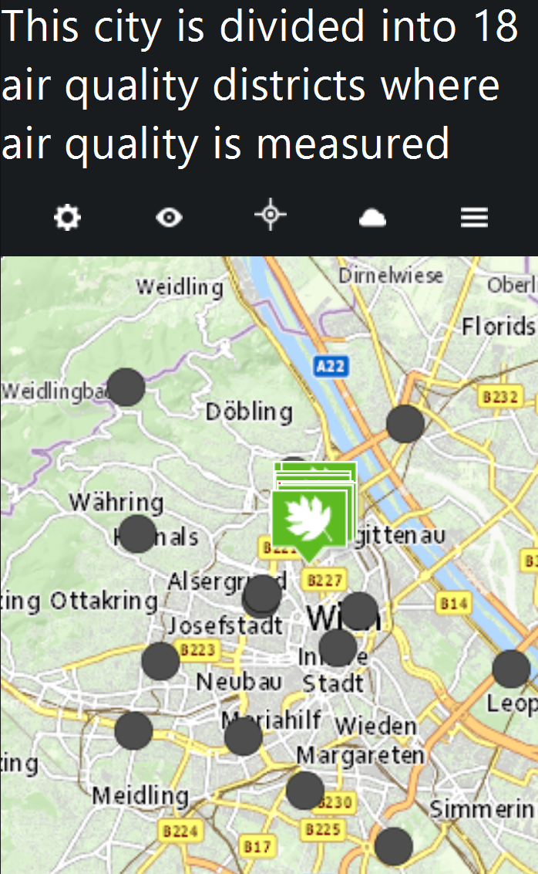
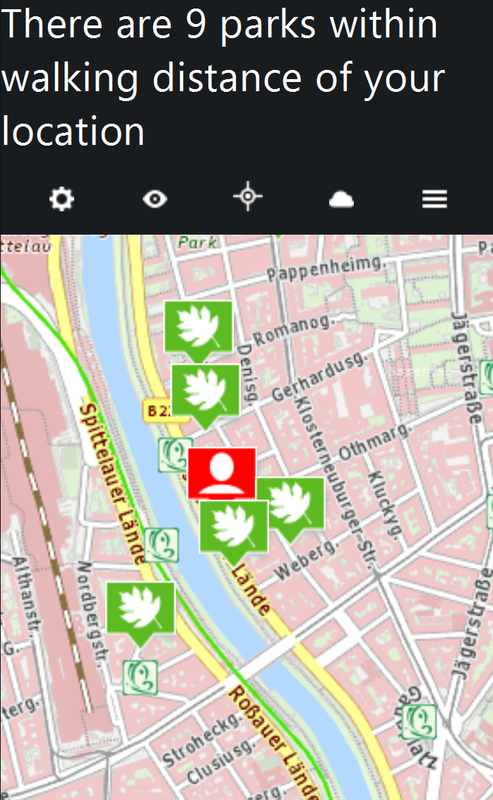
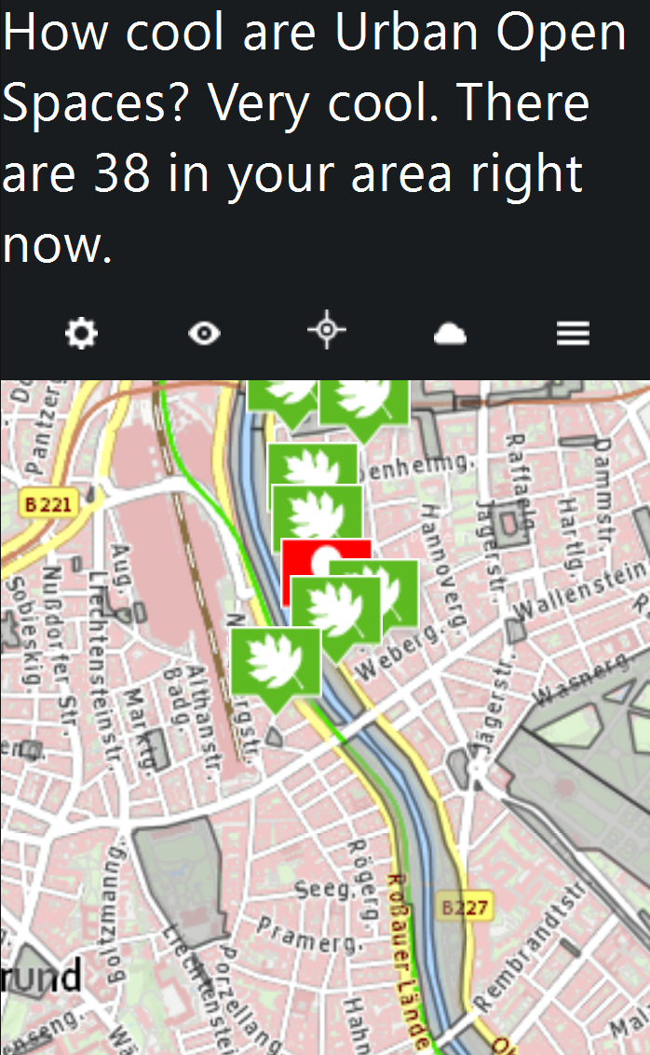
Fun Facts about your city based on data sourced live from WFS Services.
#SoMuchFun

Slide 9
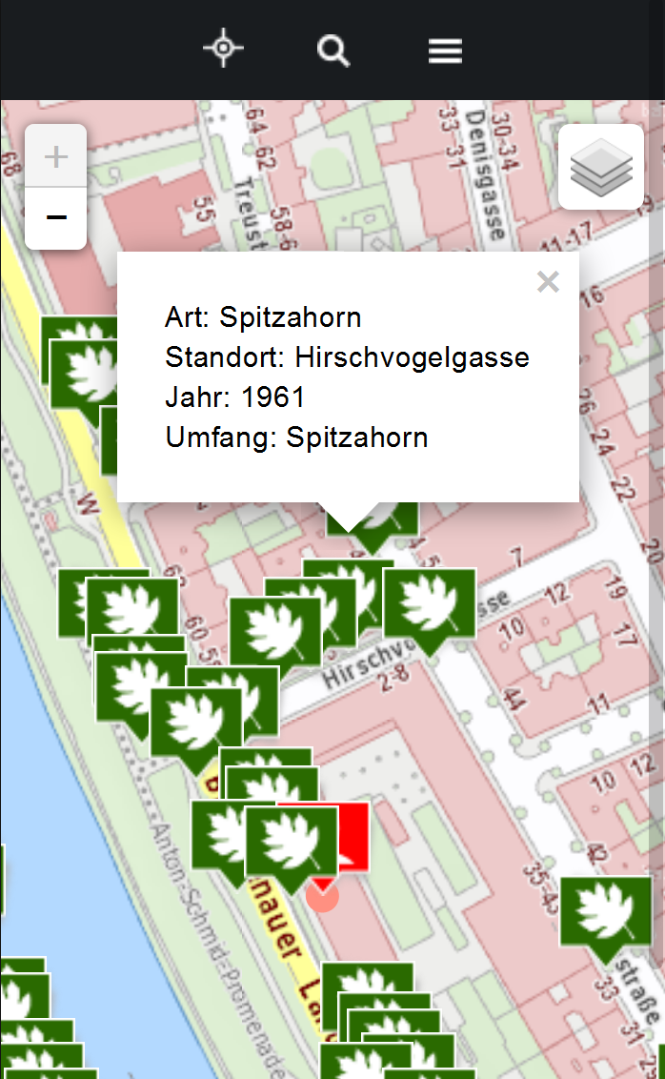
Explore your surroundings

Slide 10
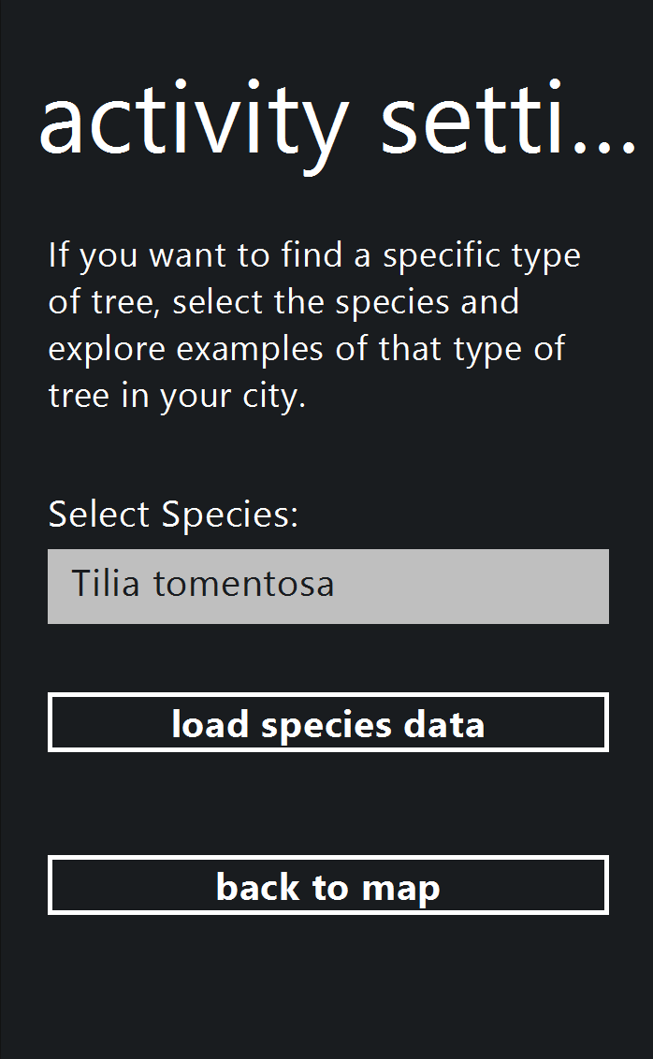
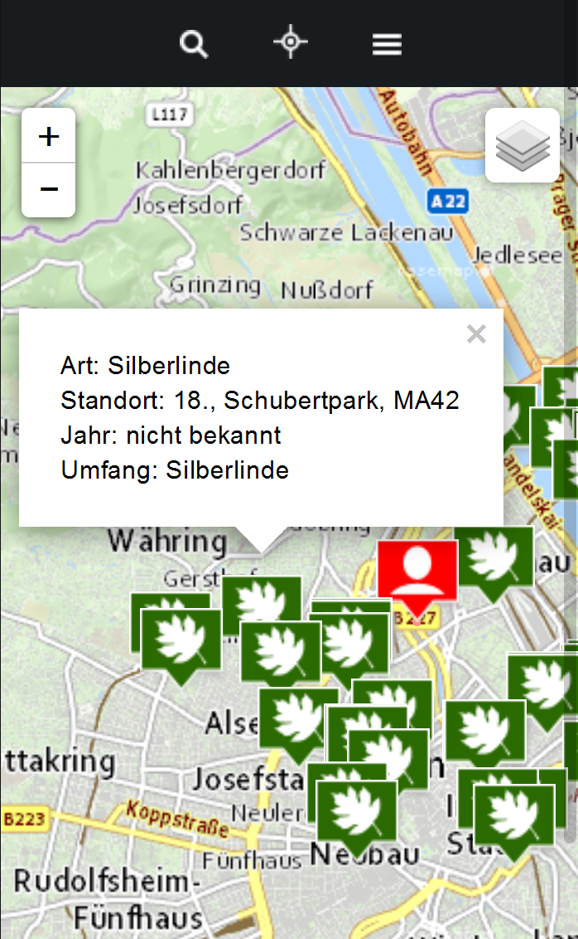
Find specific ‚targets‘
... Like cherry trees when they are in season.
(just sayin ;-)

Slide 11
Data used:
Tree inventory of Vienna
Basemap.at
OSM
WFS Services (Vienna & INSPIRE Vienna) for additional Layers and Fun Facts

Slide 12
Use Cases ...
During school sport
As a game (like for children during the summer holidays)
To promote certain aspects of city life
Create a buzz about open data
Challenges...
Incentives for users
From Open Data to Open Data
Collect movement data and derive movement patterns
>>Improve the city experience for pedestrians and cyclists

Slide 13
Thank you.
#HugATreeOnYourWayHome

